Slide 1



Toolkit for Disability Frontline Workers
A guide to helping those experiencing Family Violence

Slide 2
TRAINING PACKAGE OVERVIEW
2
The purpose of this online training is for frontline workers to gain knowledge and practical guidance around domestic and family violence within a disability perspective. This training focuses predominantly on women who have experienced domestic and family violence.
The training is in four sections:
  Background and Context
  Recognising Family Violence
  Responding to Abuse
  Referral Process
Training package development supported by funding from the Australian Government Department of Social Services.
Go to www.dss.gov.au for more information.

Slide 3
Section One
BACKGROUND AND CONTEXT

Slide 4
WHAT IS FAMILY VIOLENCE?
In Tasmania, family violence refers to violent, abusive or controlling behaviour by a person against a current or former intimate partner. This can include:
Stalking
An attempt to do any of those things
Economic abuse
Assault, including sexual assault
Emotional abuse or intimidation
Threats, coercion or verbal abuse
Breaching orders relating to family violence
Abduction
Property damage
Safe Home Families Communities Action Plan 2019-2022, p. 11

Slide 5
PREVALENCE OF DOMESTIC AND FAMILY VIOLENCE IN AUSTRALIA
One in four women has experienced violence by an intimate partner.
Women are nearly three times more likely than men to have experienced violence by a partner.
One in five women in Australia has experienced sexual violence.
One in six women have experienced an episode of stalking since the age of 15.
ANROWS 2016 Personal Safety Survey, 2017

Slide 6
PREVALENCE OF DOMESTIC AND FAMILY VIOLENCE IN AUSTRALIA
More than 70% of women with disabilities are victims of violent sexual encounters (compared to 20% of women without a disability).
90% of women with intellectual disabilities have been subjected to sexual abuse.

Slide 7
PREVALENCE OF DOMESTIC AND FAMILY VIOLENCE IN AUSTRALIA
40% of women with a disability have experienced family violence
in Australia (ABS 2018). For 68% of these women, it occurred before 18 years of age.
The incidence and prevalence of violence against women with
disabilities in Aboriginal and Torres Islander communities is estimated at over 30 times the rate for women without disabilities.
Fact Sheet: Violence Against Women Disabilities, Frohmader, C. 2014, WWDA

Slide 8
PREVALENCE OF DOMESTIC AND FAMILY VIOLENCE IN AUSTRALIA
Some of these unique forms of domestic and family violence may occur in a variety of settings, relationships and contexts.
There are many complexities
and unique forms of domestic violence that women with a disability may encounter in addition to more familiar forms.
e.g. large residential institutions, group homes, respite centres, boarding houses, private homes and on the street.

Slide 9
DISTINCTIVE FORMS OF DOMESTIC VIOLENCE FOR WOMEN WITH A DISABILITY
Frontline workers are often
the first to see women with disabilities being subjected to domestic and family violence.
Physical Violence: Withholding of food, water, medication or support services or misusing medication as a restraint, physical restraints.
Sexual Violence: Inappropriate touching during care giving or demanding sexual activities.

Slide 10
DISTINCTIVE FORMS OF DOMESTIC VIOLENCE FOR WOMEN WITH A DISABILITY
Emotional Violence: Denying or trivialising the disability, withdrawal of care or threatening to hurt guide dogs.
Financial Violence: Taking control of money or refusing to pay for essential medication or disability related equipment.
Coercion and Manipulation:
Abuse to gain control causing a power imbalance between people with a disability and people without a disability.
Lea, M. 2015, PWDA, DVNSW

Slide 11
THE LEGAL SYSTEM IN TASMANIA
The Safe at Home service system is a Tasmanian Government initiative to provide an integrated criminal justice response to family violence which is underpinned by
the Family Violence Act 2004 (Tas.).

Slide 12
WHAT ARE THE
‘LEGAL OPTIONS’
IF ABUSE IS SUSPECTED?
Legal options available include:
There are legal steps that can be taken, under the Family Violence Act, 2004 or the Criminal Code Act, 1924.
Family Violence Order (FVO)
Police Family Violence Order (PFVO)
Restraining Order (RO)

Slide 13
FAMILY VIOLENCE ACT, 2004
There are two types of orders to protect adults and children who
have experienced family violence, Police Family Violence Orders (PFVO) and Family Violence Order (FVO).
In their basic form they prohibit an alleged offender from threatening, abusing or assaulting a victim of family violence.
More restrictive orders prevent an alleged offender from approaching or contacting a victim or going to or even near places like the victim’s home, school or work.

Slide 14
WHAT IS THE DIFFERENCE BETWEEN A POLICE FAMILY VIOLENCE ORDER AND A FAMILY VIOLENCE ORDER?
Police Family Violence Order (PFVO) Can be put in place by police if they reasonably believe that the offender has committed or is likely to commit a family violence offence.
Usually orders are made for
12 months but can be longer.
If you are supporting someone, refer to a specialist family violence service.

Slide 15
If the police are not called or they do not issue a PFVO the victim is able to apply for a Family Violence Order (FVO) in the Magistrates Court against the intimate partner or ex-partner.
WHAT IS THE DIFFERENCE BETWEEN A POLICE FAMILY VIOLENCE ORDER AND A FAMILY VIOLENCE ORDER?
The Court needs to be satisfied that it
is more likely than not that:
Family violence has occurred, and
Unless restrained the person is likely to commit family violence again.

Slide 16
WHAT IS THE DIFFERENCE BETWEEN A FAMILY VIOLENCE ORDER (FVO) AND A RESTRAINING ORDER (RO)?
A Family Violence Order: Provides protection from a spouse, partner,
ex-spouse or ex-partner.
Restraining Order: Provides protection from other family members, friends, colleagues or other persons, including carers.
e.g. Violence perpetrated by a child against a parent is not considered family violence because the violence is not perpetrated by a spouse or partner.

Slide 17
BARRIERS FACED
BY PEOPLE WITH DISABILITIES WHEN APPLYING FOR A FAMILY VIOLENCE ORDER
Initial contact with police:
*Communication barriers
*The police may not be aware of the disability or it’s not taken into consideration.
*The client is not given the relevant information around family violence e.g. FVO or RO
Not having an advocate or specialist family violence service for support.
Tasmanian Regional Round Table Discussion Data, 2019

Slide 18
HOW TO APPLY FOR A FVO OR RO
Fill in an application form for
a FVO or RO.
The following organisations can help support you through this process:
Legal Aid Commission of Tasmania
Tasmanian Refugee Legal Service
Family Violence Counselling and Support Service
Women’s Legal Service
Court Support and Liaison Service
Safe Choices
Take the form plus five copies and the filing fee to the nearest Magistrates Court .
Each Tasmanian region has legal support options in place, including the support of a lawyer.

Slide 19
QUIZ: SECTION ONE
BACKGROUND
AND CONTEXT
The Quiz will open in a new browser. Keep the Quiz browser open while you complete the Training Toolkit as you will return to the quiz at the end of each section.
Good luck!
Please complete Section One (questions 1 - 5) of the Quiz
and then return to the
Training Toolkit to read Section Two.
Click HERE
to start
the quiz

Slide 20
Section Two
RECOGNISING FAMILY VIOLENCE

Slide 21
HOW TO RECOGNISE AND IDENTIFY FAMILY VIOLENCE
Nine types of abuse in detail
Physical: Causing pain, injury or fear
Sexual: Sexual harassment, assault and/or rape
Emotional/Psychological: Manipulation, coercive control or harm (verbal or nonverbal)
Financial/Economical: Control, theft or misuse of money
Cultural/Spiritual: Stopping or turning the individual’s cultural, religion or tradition against them
Social Isolation: Forced isolation from family, friends or workmates
Verbal: Shouting or intimidation in person or via text/email
Stalking: Harassment by following in person or using a tracking device
Technological: Image based abuse – using images without permission

Slide 22
DULUTH POWER
AND CONTROL WHEEL – PEOPLE WITH DISABILITIES AND THEIR CAREGIVERS
In the next slide the complexities and unique forms are highlighted in more detail with the Duluth Power and Control Wheel – people with disabilities and their caregivers.
Developed by Wisconsin Coalition Against Domestic Violence and based on the model by the Domestic Violence Intervention Project.

Slide 23
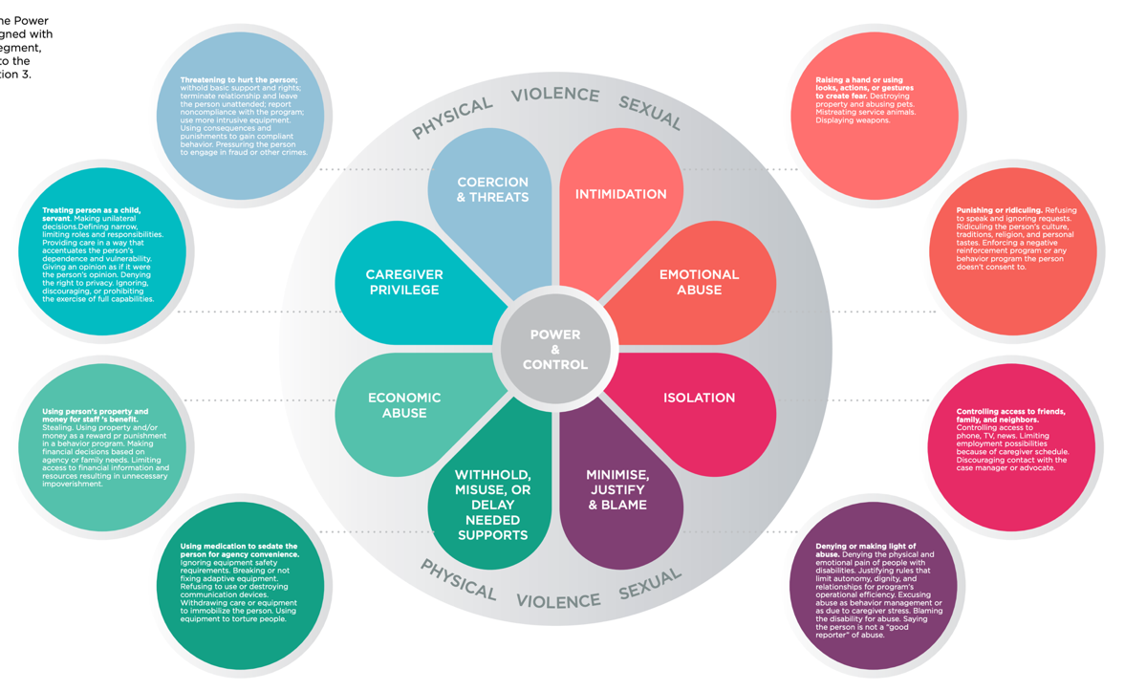


Slide 24
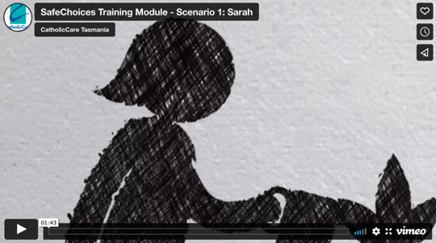
RECOGNISING
FAMILY VIOLENCE
Case Study – ‘Sarah’
In this case study there are
many indicators of Family Violence.
Can you identify the types of abuse that Sarah has been subjected to?

Slide 25
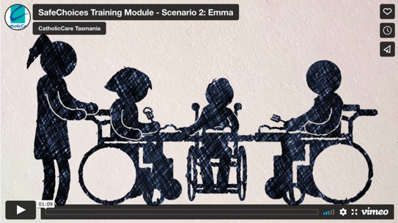
RECOGNISING
FAMILY VIOLENCE
Case Study – ‘Emma’
As you watch the second video, see if you can recognise some of the complexities and layers of domestic and family violence within a disability context.

Slide 26
RECOGNISING DISCLOSURES
Frontline workers are likely to be the people whom disclosures are made to from women with disabilities.
Many disclosures will not be made verbally, but may be made with more subtle signs that indicate violence is occurring.

Slide 27
SIGNS THAT SOMEONE COULD BE A VICTIM OF FAMILY VIOLENCE
Being intimidated or frightened by their partner or caregiver
Being withdrawn and reluctant to speak
Being overly anxious of their partner or caregiver
Revealing that their partner or caregiver constantly follows, calls or texts them where they are, what they are doing and who they are with.
Revealing they are regularly criticised or verbally put down by their partner or caregiver.

Slide 28
SIGNS THAT SOMEONE COULD BE A VICTIM OF FAMILY VIOLENCE
Revealing that their partner is jealous or possessive
Referring to their partner or caregiver as having a bad temper or being moody.
Repeatedly having bruises, broken bones or other injuries
Revealing that their partner or caregiver controls their money

Slide 29
DISCLOSURES – INCLUDING NON-VERBAL DISCLOSURE
Hyper-vigilance
Showing increased occasions of self harm
Anxiety
Avoiding people who are similar to the perpetrator.
Feeling sick
Unexplained restraint in particular company
Less (or more) talkative
Unexplained injury
Heightened level of spasm
Lifeline Australia DV-Alert Disability, 2018, p. 74

Slide 30
DISCLOSURES – INCLUDING NON-VERBAL DISCLOSURE
Frequent crying
Having headaches
Lack of money
Changed reaction to touch
Being withdrawn
Frequent touching of genitals
Ignoring self-care
Always accompanied by a support worker
Lifeline Australia DV-Alert Disability, 2018, p. 74

Slide 31
Adapted from: Early warning signs,
Looking after me Project Resources Kit,
2012, Penrith Women’s Health Centre

Slide 32
BARRIERS TO DISCLOSURE
Inaccessible information
and communication
Physical inaccessibility
Attitudes and experiences
about people with a disability
Perceived discrimination
Loss of supports

Slide 33
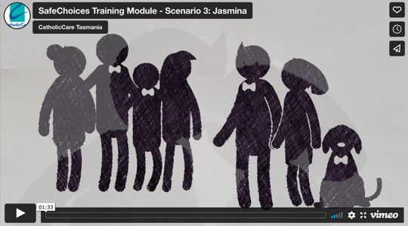
RECOGNISING
FAMILY VIOLENCE
Case Study – ‘Jasmina’
Now that you’ve worked through some of the complexities and unique forms of domestic and family violence, are you able to identify in this third video some of the subtleties of abuse that women with a disability live with?

Slide 34
QUIZ: SECTION TWO
RECOGNISING FAMILY VIOLENCE
Please go to the Quiz browser
and answer the Quiz questions
for Section Two (questions 6 - 8).
After you have answered these three
questions, return to to the Training Toolkit to read Section Three.

Slide 35
Section Three
RESPONDING TO ABUSE

Slide 36

HOW DO FRONTLINE WORKERS RESPOND?
COMMUNICATION
FOLLOW MY LEAD
ASSESSMENT TOOLS
PATHWAY TO SAFETY
Pictograms of domestic and family violence
Four step approach:
Ask, Name it, Refer, Follow up
Empowerment circle:
Disability friendly
Safety planning
See video on slide 38

Slide 37
COMMUNICATION TOOLS
Pictograms of Domestic and Family Violence
Controlling your money
Hurting
you
Stopping you seeing people
Making threats
Unwanted sex
Shouting
at you
Spying
on you
Stalking
you
Stopping your religion or customs

Slide 38

FOLLOW MY LEAD
How ready are you as a worker
to respond if your client shares with you?
How you respond to your client when they share, and in the time that follows, matters to your client significantly.
A good first step is to learn more about the world of your client and how the violence harms their safety and wellbeing.

Slide 39
ASK: For example, do you feel safe in your home? Ask this sensitively and in a safe environment.
ASSESSMENT TOOLS: RECOGNISING DISCLOSURES
NAME IT: Call it what it is, and let them know that what they’re experiencing is violence or abuse and it is not okay for someone to treat them that way.
If you use the four step approach, be mindful that it is direct in its questioning.
Ask with understanding and empathy.
REFER: If in immediate danger, call 000. If not, refer them to a specialist service or give them enough information
(if safe to do so) to self-refer.
FOLLOW UP: Keep in touch with
the person. Ask if they feel
supported and actively
check on their safety.
1800 RESPECT TAKE A STAND: Responding to Domestic Violence – Rosie Batty

Slide 40
ASSESSMENT TOOLS:
THE EMPOWERMENT CIRCLE
The orange shading represents layers of poor practice and disempowerment e.g. is the client aware of different relationships, can they identify a healthy relationship
The Empowerment Circle is a visual representation that helps workers assess needs of client.
The purple outer edge of the circle represents abusive and criminal practice e.g. the client has disclosed to you about unwanted touching from another worker
The gold area represents good practice, with the person in the middle (the client) representing empowerment and control over all areas of their life
Discuss with your client where they think they sit on the circle
For more information on how to use this assessment tool refer to the online training Cerebral Palsy E-Learning

Slide 41
ASSESSMENT TOOLS: THE EMPOWERMENT CIRCLE
ABUSIVE/CRIMINAL
POOR/NEGLECTFUL
GOOD PRACTICE

Slide 42
PATHWAY TO SAFETY
Safety Planning is a crucial
step in supporting clients to
a ‘Pathway to Safety’.
Here is a guide on how you, as a frontline worker, can support your client if disclosure has occurred:
Ask your client to start thinking about their own safety
Inform your client of all the options available

Slide 43
PATHWAY TO SAFETY
Inform your client that a safety plan can only occur in consultation with them.
Inform your client that if they choose to stay in the family home where they are experiencing family violence, a specialist family violence service can still create a safety plan with them for within the home.
Inform your client of specialist family violence services that are available to develop a tailored safety plan for them.
Identifying Family Violence & Responding to Women and Children, 2017, NWMR, p.16

Slide 44
WHAT WOULD A SAFETY PLAN LOOK LIKE?
It is important to ask your client what they are already doing to ensure safety for themselves:
- Include this in the plan
Other strategies to consider in the plan:
Call the police if there is immediate danger
Establish a safe place to go and plan for transport options
Identify trusted friends, family members or neighbours to assist in an emergency

Slide 45
WHAT WOULD A SAFETY PLAN LOOK LIKE?
Other strategies to consider in the plan:
Refer to family violence support services
Link in with disability advocacy services
Store phone numbers on mobile – on speed dial
E-safety – eliminate being tracked by smartphone
For more information refer to the Resource Manual
Identifying Family Violence & Responding to Women and Children, 2017, NWMR, p.16, 17. Lifeline Australia, DV-Alert Disability, 2018, p. 151

Slide 46
SAFETY PLAN CHECKLIST
Identification Documents:
Drivers licence
Passport
Birth certificate (including children)
Centrelink card
Medicare card
Immigration papers (if applicable)
Legal Documents:
Lease contracts
Marriage or divorce papers
Restraining orders
Custody orders
Work permits (if applicable)

Slide 47
SAFETY PLAN CHECKLIST
Personal Belongings:
House and car keys
Medication (including prescriptions)
Mobile phone
Photographs
Jewellery
Clothes
Address book
Children’s toys
Pets (if you can)
Any personal items which
could be destroyed
Financial Matters:
Bank account details
Credit card and some cash

Slide 48
IMMEDIATE DANGER - POLICE RESPONSE
On arrival, the police will determine the risk factors for your client by evaluating the situation through two assessments:
If there is a safety risk for your client and they are in immediate danger, don’t hesitate to call the police on their behalf or encourage your client to call themselves.
Family Violence Risk Assessment Screening Tool; gauging the risk factors and assessing safety.
Family Violence Safety Audit; has been designed to increase the physical safety and awareness of
the issues concerning the current incident.

Slide 49
REFERRAL PROCESS
Referrals should be made in consultation with the client with their informed consent, except where there are immediate safety and risk concerns for the victim or others. (Refer to previous slide)
Referral to support services is an important component of care. It is the process of making contact with or providing information to a specialist service provider and/or to access a service on behalf of a victim – adult or child.
If there are any children in the household, mandatory reporting requirements will need to be followed.
Responding to Family Violence, 2017, p. 19

Slide 50
DISCUSSING REFERRAL OPTIONS
The referral process should be guided by the client’s preferences and needs. The option for referral to appropriate services should be introduced with an explanation of:
The purpose of the referral
The information that will be shared to facilitate the referral
The possible outcomes of the referral (including benefits and risks)
Any response or actions that may be taken after the referral

Slide 51
DISCUSSING
REFERRAL OPTIONS
If your client declines, is unwilling or unable to accept a referral to support services, this decision must be respected.
Women with disabilities may decline offers of assistance for a number of complex reasons e.g. fear of losing their children, finances or housing stress.

Slide 52
DISCUSSING
REFERRAL OPTIONS
If your client indicates they
DO NOT want assistance:
Provide them with written information and contact details of services
Leaving a violent relationship is the time when a client is most at risk of experiencing violence or for the violence to escalate.
Attempt to arrange ongoing contact
Inform them Child Safety Services will be notified if children are experiencing violence and there are concerns for the children’s safety and wellbeing
Responding to Family Violence, 2017, p. 20

Slide 53
REFERRAL
GUIDE
Client in contact with mainstream service
Revised Version: Original Graphics courtesy of Domestic Violence Resource Centre Victoria
Indicators of family violence present
Client discloses family violence
Client is in immediate danger and willing to receive assistance contact the Tasmanian Police.
Client is not in immediate danger and willing to receive assistance refer to family violence services for full assessment (SafeChoices).
Yes
Client is in immediate danger and not willing to receive assistance contact the Tasmanian Police.
Client is not in immediate danger and not willing to receive assistance provide information about available supports and monitor closely.

Slide 54
PATHWAY TO SAFETY
In this next group of slides we are going to use the Emma Case Study from section 2 to focus on a practical guide to navigate a ‘Pathway to Safety’.
The following scenario (Case Study: Emma) is a whole of Tasmania example of the procedures, protocols and duty of care for clients under supported accommodation circumstances.

Slide 55
PATHWAY TO SAFETY
Case Study ‘Emma’ (Refer to video slide 25)
45yr old Emma has a physical disability and uses a wheelchair. Emma lives in a supported accommodation facility where she has lived for most of her adult life as she needs practical help with her daily needs. Emma is very much dependent on the support workers to help her with showering and her personal hygiene.
Emma has been happy and content overall, in this group home for many years.
Recently a new support worker joined the care team. In the beginning, Nick the new worker was nice to Emma but his behaviour began to change as time went on.

Slide 56
PATHWAY TO SAFETY
Case Study ‘Emma’ Continued…
Nick would touch Emma inappropriately during care-giving. When Nick showered and washed Emma’s hair he would use cold water
as a punishment because Emma would tell Nick she didn’t like what he was doing to her. Nick never showed his abusive behaviour when other workers were around.
Lisa, another support worker, noticed that Emma had become withdrawn, less engaging with the other residents and workers, and whenever Nick came in the room Emma would be anxious and distressed. Lisa asked Emma why she was agitated and upset, Emma then tells Lisa what has been happening.

Slide 57
WHAT IS EMMA’S PATHWAY TO SAFETY?
As frontline workers, what would be your strategy to support Emma?
In this scenario there are many issues that are going on for Emma.
How would you respond if you were Lisa?
What are the protocols and procedures the supported accommodation facility has in place for this particular situation?
SafeChoices Resource Manual

Slide 58
PROCESS OF REPORTING
Lisa responds by reassuring Emma, as Emma is anxious about what will happen and if Nick will still be her support worker.
Lisa follows up by reading through the policies of the organisation and reports Nick’s behaviour to her manager.
Lisa tells Emma that she will speak with management about the abuse and Lisa engages a specialist family violence service to provide a safety plan for Emma in the meantime.
Lisa knows her rights under the NDIS Code of Conduct ‘whistle-blower protection’ legislation.
The NDIS Code of Conduct: Guidance for Workers, 2019, p. 25, 26

Slide 59
QUIZ: SECTION THREE
RESPONDING TO ABUSE
Please go to the Quiz browser
and answer the Quiz questions for Section Three (questions 9 - 12).
After you have answered these four questions, return to to the Training Toolkit to read Section Four.

Slide 60
Section Four
REFERRAL PROCESS

Slide 61
DUTY OF CARE AND RESPONSIBILITY
Frontline workers have a duty of care to report incidents of violence and exploitation to the organisations (NDIS provider) or management that they are contracted to work for.
The framework of the NDIS Code of Conduct – Guidance to Workers 2019 supports the workers in their response and actions when reporting an incident.

Slide 62
WHAT IS DUTY OF CARE?
‘A disability support worker has a duty of care to the person with a disability that they are supporting and others in the general community when working within a community environment.’
‘A duty of care is breached if a person behaves unreasonably or fails to act (which can also be unreasonable in a particular situation).’
‘A duty of care can be breached either by action or inaction.’
CODA Disability Support Association, Qld

Slide 63
REFERRAL PROCESS
In this next group of slides we are going to use the Jasmina Case Study from section 2 to focus on a practical guide to navigate the referral process.
The following scenario (Case Study: Jasmina) outlines Jasmina’s experience of abuse within an intimate relationship with Joe, along with possible referral pathways for Jasmina. There may be other services or support networks available to Jasmina in her local area.

Slide 64
REFERRAL PROCESS
Case Study ‘Jasmina’ (Refer to video slide 33)
Jasmina is 28 years old and is visually impaired. Jasmina relies on her guide dog Lucy and her computer for everyday tasks. Jasmina has been with her partner Joe for three years. They met at university where they were both studying their undergraduate degrees. Jasmina continued her education by studying a PhD in classical literature.
Jasmina and Joe had a good relationship in the beginning; they laughed and Joe seemed to be understanding of Jasmina’s disability. It seemed the cracks only started to appear in their relationship after they were recently married.

Slide 65
REFERRAL PROCESS
Case Study ‘Jasmina’ Continued…
Joe became controlling; denying Jasmina contact with her family and friends. Jasmina comes from a large family, family is very important to Jasmina so being isolated from them has made her feel vulnerable and scared.
The only time Jasmina would be allowed out on her own is when she went to supervision meetings with her professor at the university and meetings with her NDIS providers.
Joe became jealous and more controlling and Jasmina is concerned that Joe may have put a tracker on her phone. Joe would also shift the furniture around and move objects while she was out. Jasmina thought she was going crazy.
The continual abuse had taken a toll on Jasmina who divulged what is happening with her NDIS coordinator during a scheduled review.

Slide 66
WHAT IS THE REFERRAL PROCESS FOR JASMINA?
Jasmina was able to confide in her local area coordinator during her scheduled meeting.
Jasmina has an NDIS package with minimal support services as Joe is the main caregiver. Joe also manages the household finances.
Jasmina is not in any immediate physical danger but needs to seek assistance on how to move forward – a Pathway to Safety. We know this is a crucial time where the abuse can escalate.
The following page provides an example of a possible referral/pathway to safety for Jasmina.

Slide 67
REFERRAL PATHWAY
CARE PROVIDER
SPECIALIST FAMILY VIOLENCE SERVICE
POLICE
HOUSING SERVICES
SafeChoices: 1800 806 189
(safety/exit planning)
Family Violence Counselling Support Service: 1800 819 447
Disability Advocacy Service: 1800 005 131
Emergency Services:
Triple Zero - 000
Police Assistance non-emergency:
131 444
Housing Connect: 1800 800 588
Disability housing provider through NDIS coordinator
Disability Advocacy Service: 1800 005 131

Slide 68
QUIZ: SECTION FOUR
REFERRAL PROCESS
Please go to the Quiz browser and answer the quiz Questions for Section Four (questions 13 and 14).
Once you have answered these last two questions, you have completed the Training Toolkit and the Quiz.
There is a section at the end of the Quiz (question 15) for you to provide us with your contact details so that we can issue you with a Completion Certificate.
Thank you for your participation.

Slide 69
SPECIALIST FAMILY VIOLENCE SERVICES
STATEWIDE | Family Violence Counselling and Support Service | 1800 608 122
STATEWIDE | SafeChoices | 1800 806 189
STATEWIDE | Engender Equality | 03 6278 9090
STATEWIDE | Australian Childhood Foundation | 1300 381 581
NORTH | Yemaya Women’s Support Service | 03 6334 0305
NORTH WEST | Anglicare (Relationship Abuse of an Intimate Nature) | 1800 243 232
SOUTH | Huon Domestic Violence Service | 03 6264 2222
STATEWIDE | Tasmanian Sexual Assault Crisis Line | 1800 697 877
STATEWIDE | Housing Connect | 1800 800 588
STATEWIDE | Legal Aid Commission of Tasmania | 1300 366 611

Slide 70
THE SPEAK UP FRAMEWORK IS BASED ON GLOBAL,
NATIONAL AND TASMANIAN VALUES AND PHILOSOPHIES
The United Nations Convention on the Rights of Persons with a Disability (CRPD)
The Disability Discrimination Act
The United Nations Declaration of Human Rights
Australian National Plan to Reduce Violence against Women and their Children: Action Plan 2010 - 2022
Family Violence Act, 2004

Slide 71
APPENDIX
The United Nations Convention on the Rights of a Person with a Disability (CRPD)
Three R’s (Recognize, Respond, Refer)
ABS (Australian Bureau of Statistics)
Tasmania (Tas)
Police Family Violence Order (PFVO)
Family Violence Order (FVO)
Restraining Order (RO)
National Disability Insurance Scheme (NDIS)
Local Area Coordinator (LAC)

Slide 72

THANK YOU FOR TRAINING WITH SAFECHOICES
If you would like more information about what has been studied, refer to the Resource Manual for additional resources and references.
Training package development supported by funding from the Australian Government Department of Social Services.
Go to www.dss.gov.au for more information.

